Slide 1
Jasper Reporting
"Visualize Your Data Like Never Before "
- JasperReports

Slide 2
Introduction
JasperReports is a popular open-source reporting tool that allows developers to create dynamic, pixel-perfect reports for various business applications. It was developed by JasperSoft and later acquired by TIBCO Software Inc.
JasperReports provides a wide range of features that enable developers to generate highly customizable reports that can be exported to different formats, including PDF, HTML, Excel, and CSV. The tool uses an XML file format to define the report layout, data sources, and data fields, which can be easily integrated into various Java-based applications.

Slide 3
Key Features
Report design: JasperReports provides a drag-and-drop interface for designing report templates and supports various report elements, including tables, charts, and images.
Data connectivity: JasperReports supports a wide range of data sources, including JDBC, XML, and custom data sources.
Report generation: JasperReports allows developers to generate reports on-demand or schedule them to run at specific intervals.
Report exporting: JasperReports provides multiple options for exporting reports to different formats, including PDF, HTML, Excel, and CSV.
Report customization: JasperReports provides a rich set of APIs for customizing report generation, formatting, and output.

Slide 4
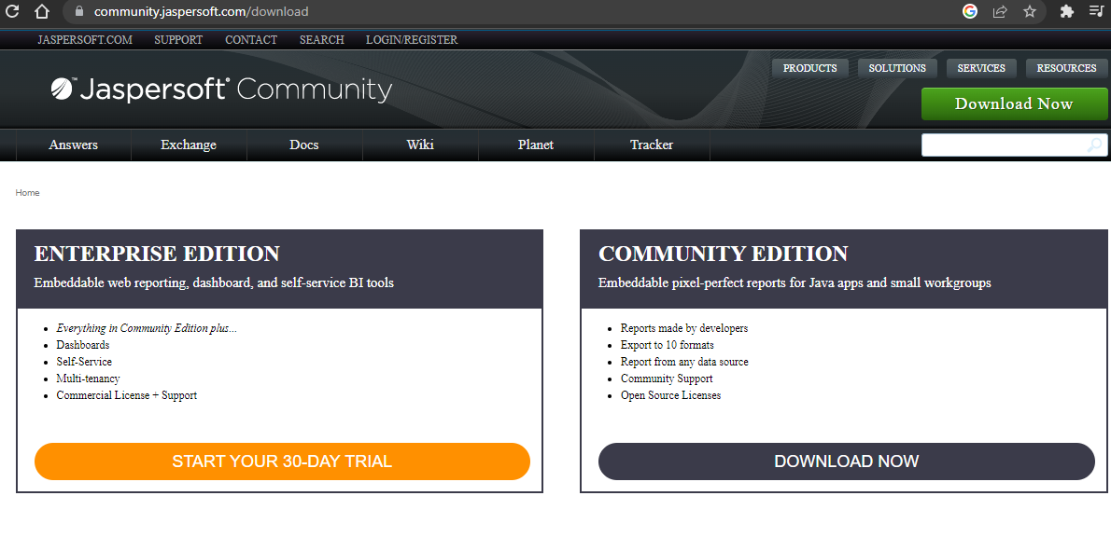
Hands on Jasper with Springboot
https://community.jaspersoft.com/download
Download Community Edition

Slide 5
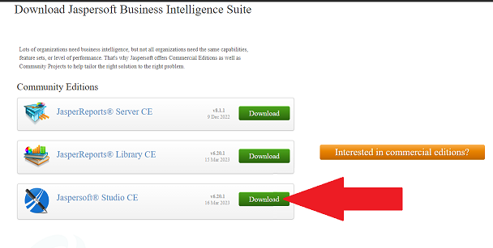

Slide 6
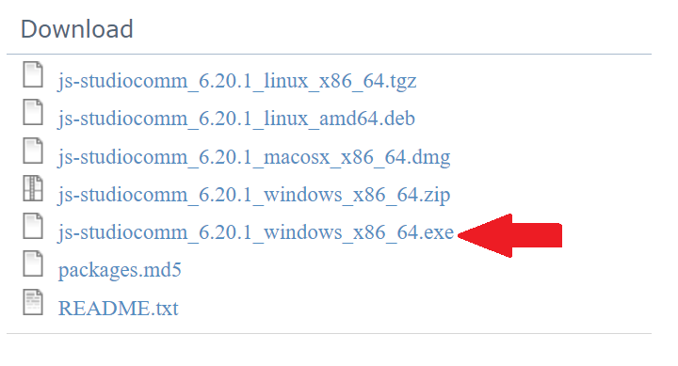

Slide 7
Download Link
https://sourceforge.net/projects/jasperstudio/files/JaspersoftStudio-6.20.1/js-studiocomm_6.20.1_windows_x86_64.exe/download

Slide 8
Steps To Work With Jasper Studio

Slide 9
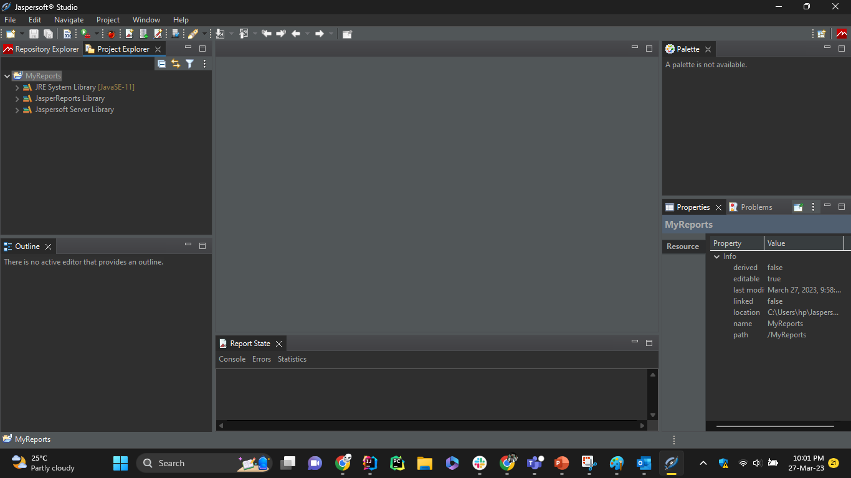
Jasper Studio

Slide 10
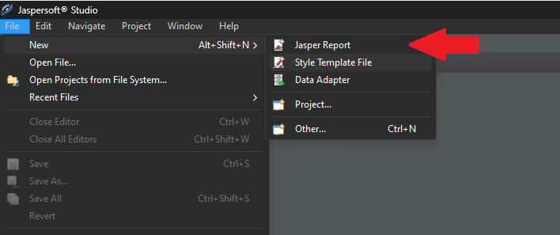
Click File
Select New
Select Jasper Report
Select Simple Blue

Slide 11
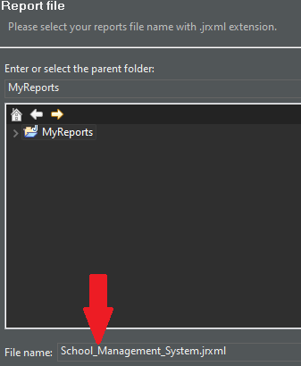
Rename the file
Click Next

Slide 12
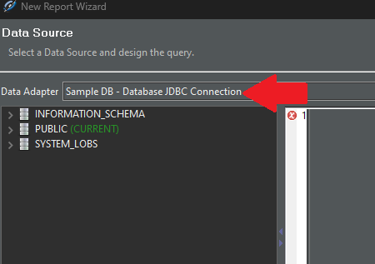
Select SampleDB in Data Adapter

Slide 13
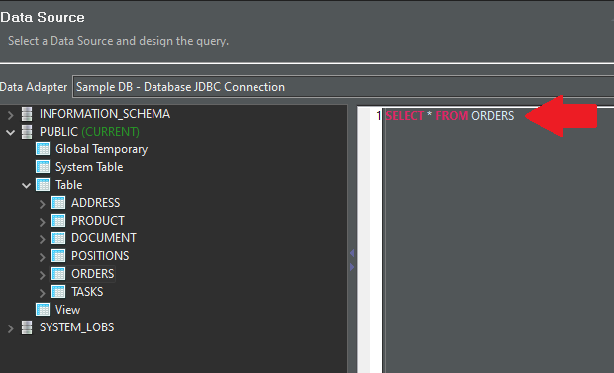
We are going to use sample tables
Later we will customize these for our need
Write the query for orders
Click Next to run the query

Slide 14
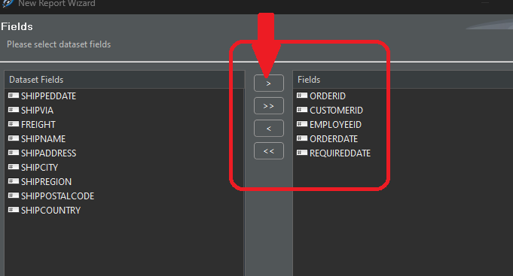
Select any number of fields that you want
You can select multiple by ctrl+click
Add them by clicking > symbol

Slide 15
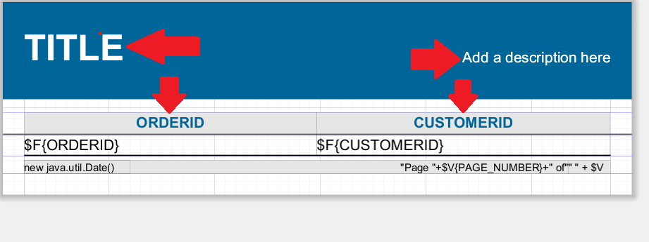
Update the fields as per your need

Slide 16
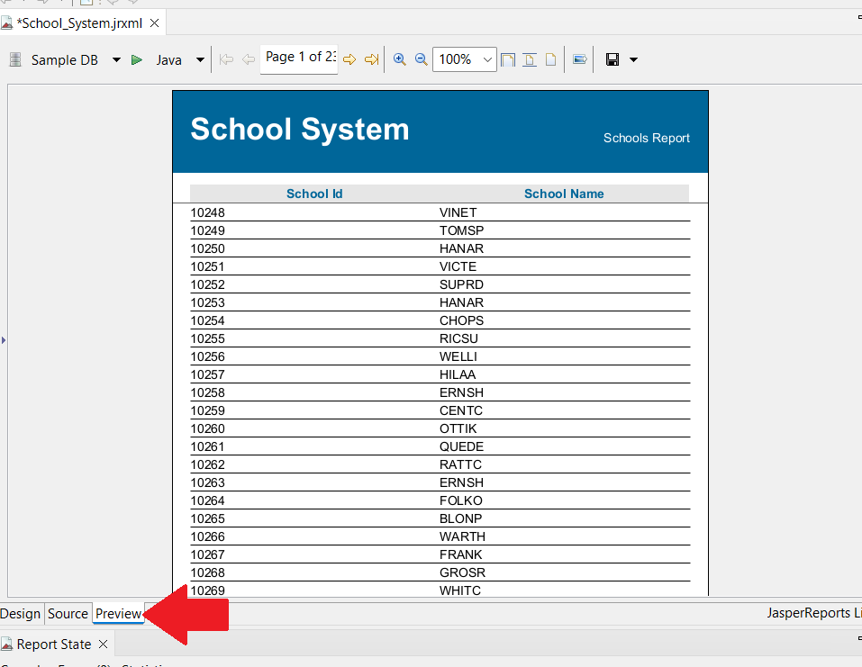
Click Preview to see Preview of report with sample data

Slide 17
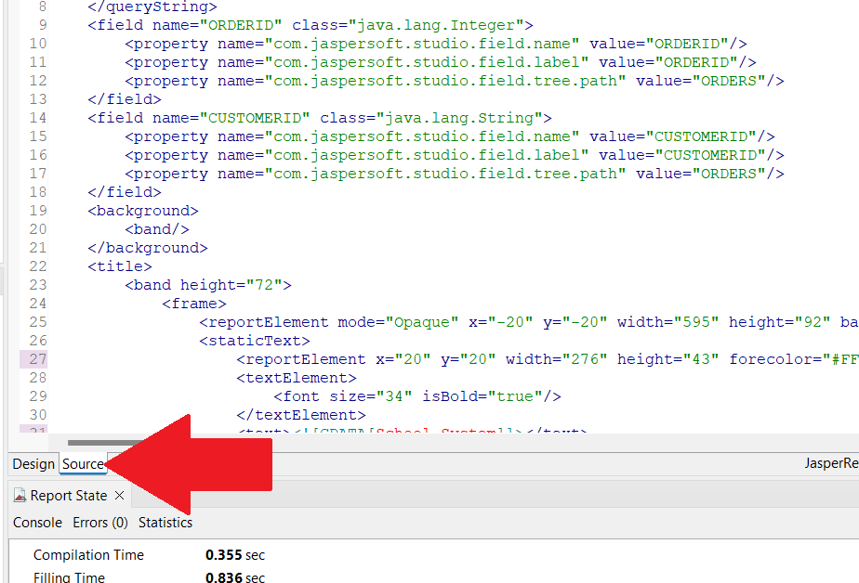
Click Source and Copy

Slide 18
Steps To Work With Springboot

Slide 19
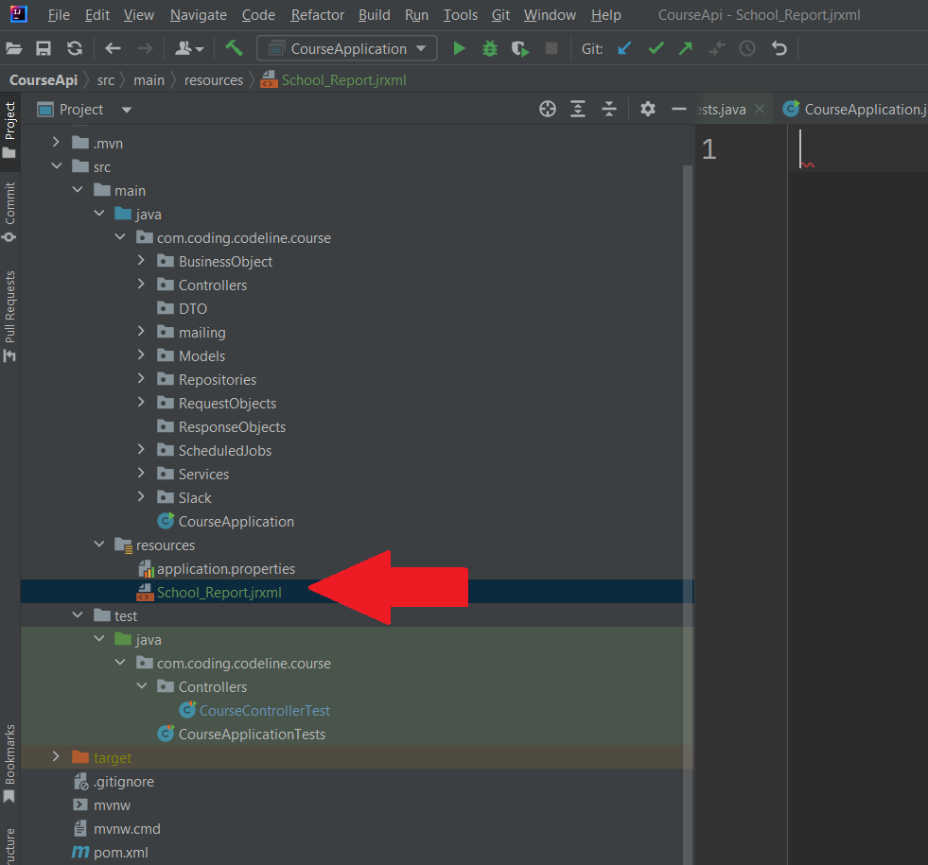
Goto your Springboot project
In the resources package create a file School_Report.jrxml
Paste all the copied code from Jasper Studio to this new file we just created

Slide 20
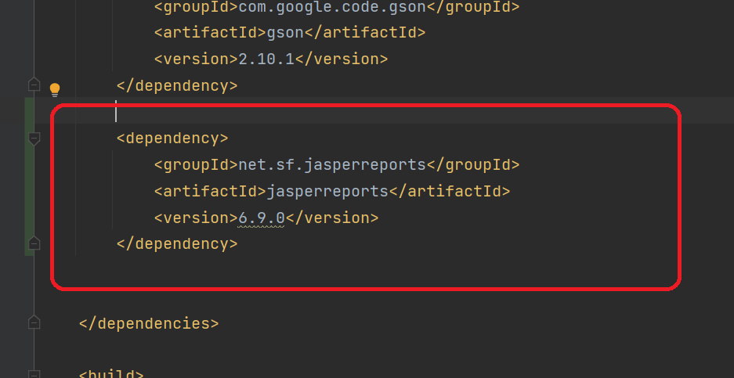
Add following dependency to your project:
<dependency>
<groupId>net.sf.jasperreports</groupId>
<artifactId>jasperreports</artifactId>
<version>6.20.1</version>
</dependency>

Slide 21
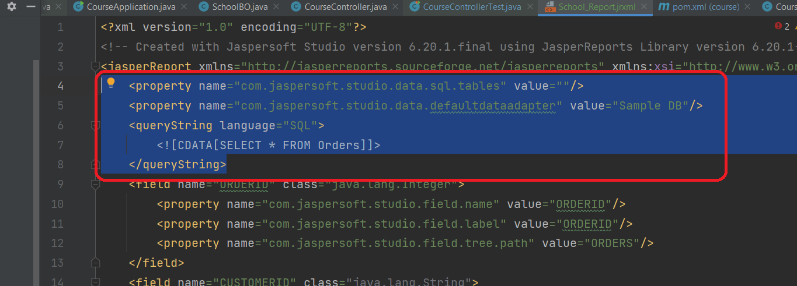
We remove the highlighted parts

Slide 22
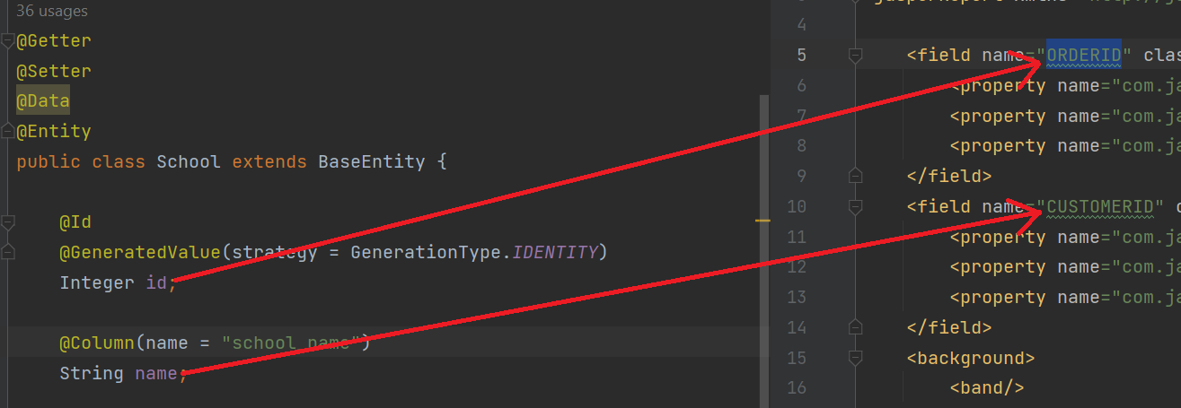
Update names of fields as per our class attributes
Remove properties under the field name tags
Ensure that variable data types are same as the model

Slide 23
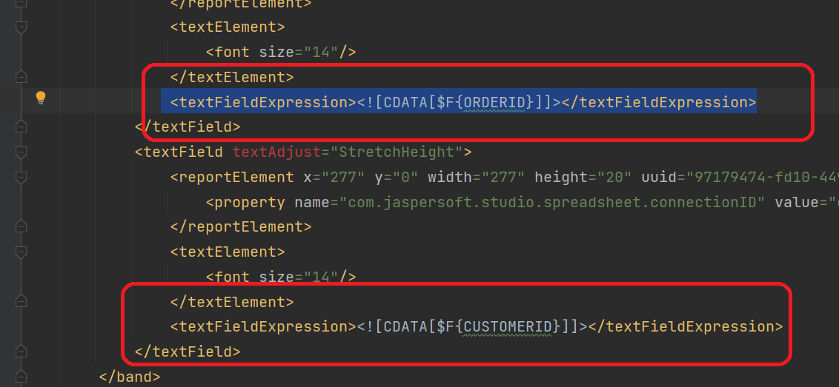
Scroll down to <textFieldExpression> tags and update
In above example: ORDERID becomes id, CUSTOMERID becomes name

Slide 24
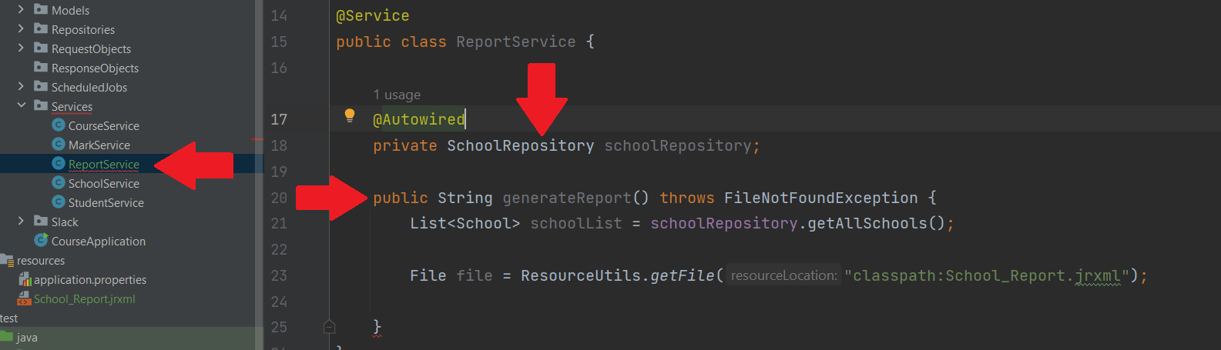
Create ReportService
Write Function to create report for all schools

Slide 25
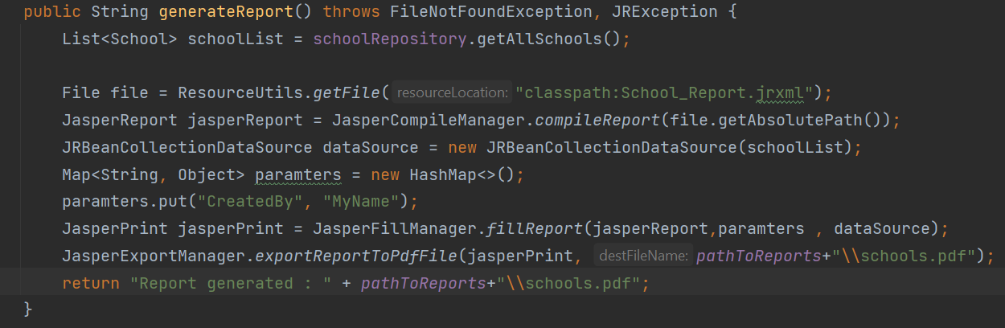
Get Schools from Database
Create File object and initialize it with our report format file
Define source of data for the report

Slide 26
Give parameters for file information
Insert data into file and print the file
Export the file to pdf file in a specified directory

Slide 27
